Slide 1
DAI 1000
Digital and AI Literacy
L11 - AI Application

Slide 2
Class Objectives
1. Recap of 3 Agent Types
2. Workflow Agent Demo and Practice
  English Version Instruction (coze.com)
  Chinese Version Instruction (coze.cn)

Slide 3
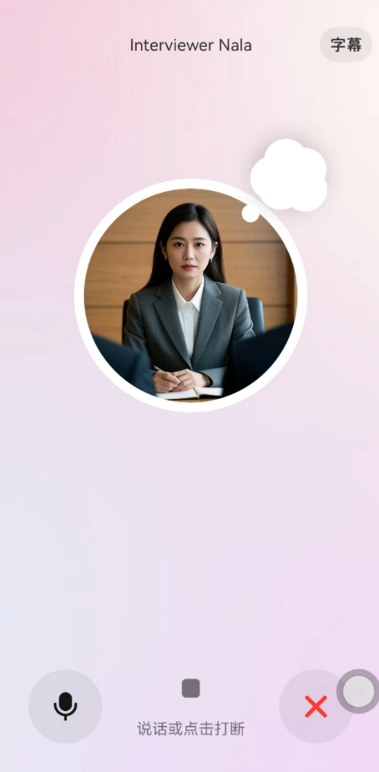
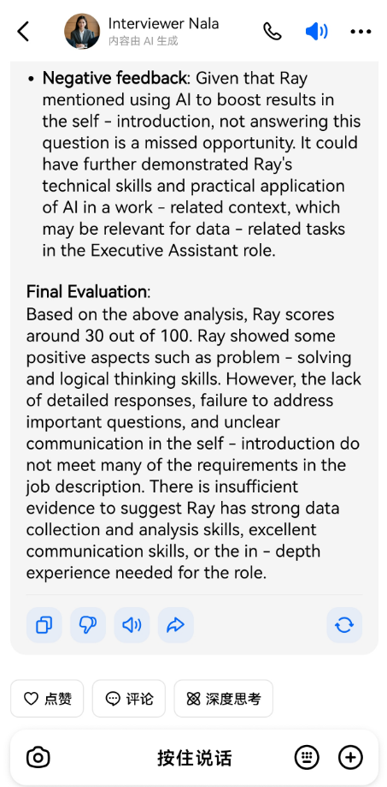
Three Categories of AI Agents
Role-Based Agents
How they work: have a specific job or role, following set rules.
What they're good at: reliable, just like you'd expect someone in their role to be.
Where you see them: virtual interviewers, customer service, and educational tutors.

Slide 4
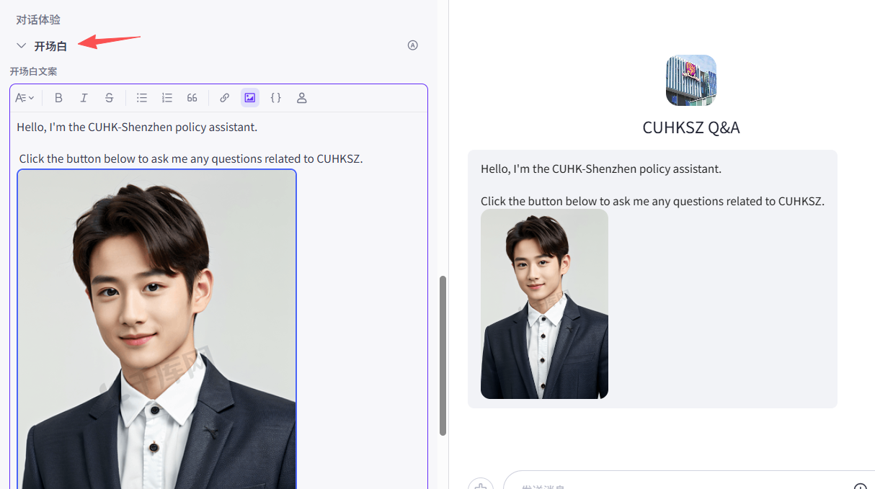
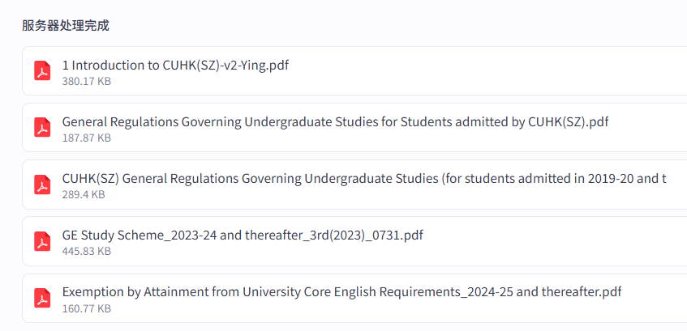
Three Categories of AI Agents
Role-Based Agents
RAG Agents
How they work: have a specific job or role, following set rules.
How they work: add information from specific sources (like a company).
What they're good at: giving accurate answers, especially on specific topics.
What they're good at: reliable, just like you'd expect someone in their role to be.
Where you see them: medical chatbots, legal helpers, tech support systems, or tools for academic research.
Where you see them: virtual interviewers, customer service, and educational tutors.

Slide 5
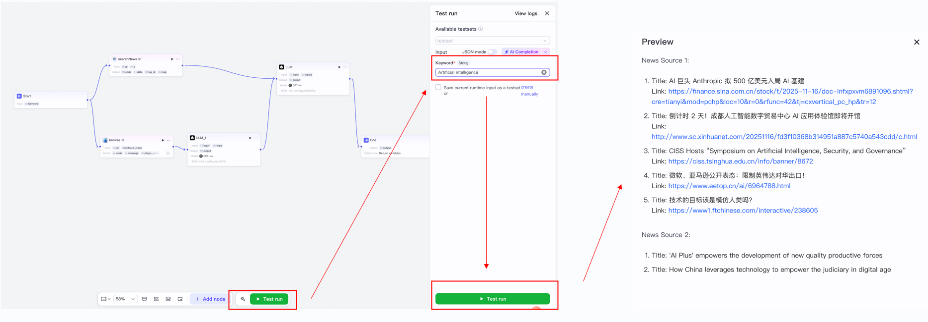
Three Categories of AI Agents
Role-Based Agents
Workflow Agents
How they work: have a specific job or role, following set rules.
How they work: handle big tasks by using different tools and programs.
What they're good at: managing many steps, making sure everything works together smoothly.
What they're good at: reliable, just like you'd expect someone in their role to be.
Where you see them: virtual interviewers, customer service, and educational tutors.
Where you see them: booking trips, analyzing data, making reports automatically, or controlling a smart home.

Slide 6
Workflow Agent Benefits
1
Automation of Repetitive Tasks
2
Scalability Across Sources and Tasks
The agent can continuously execute routines, such as data collection, filtering, and summarization.
An agent can handle large volumes of data from multiple channels, such as various websites and social media.
3
Seamless Integration with Other Tools
4
Personalization and Flexibility
it can coordinate different tools (e.g., browsers, spreadsheets, APIs, databases) to finish the whole task, without manual intervention.
Users can design their own workflows, allowing the AI agent to adapt to individual goals, interests, or organizational needs.

Slide 7
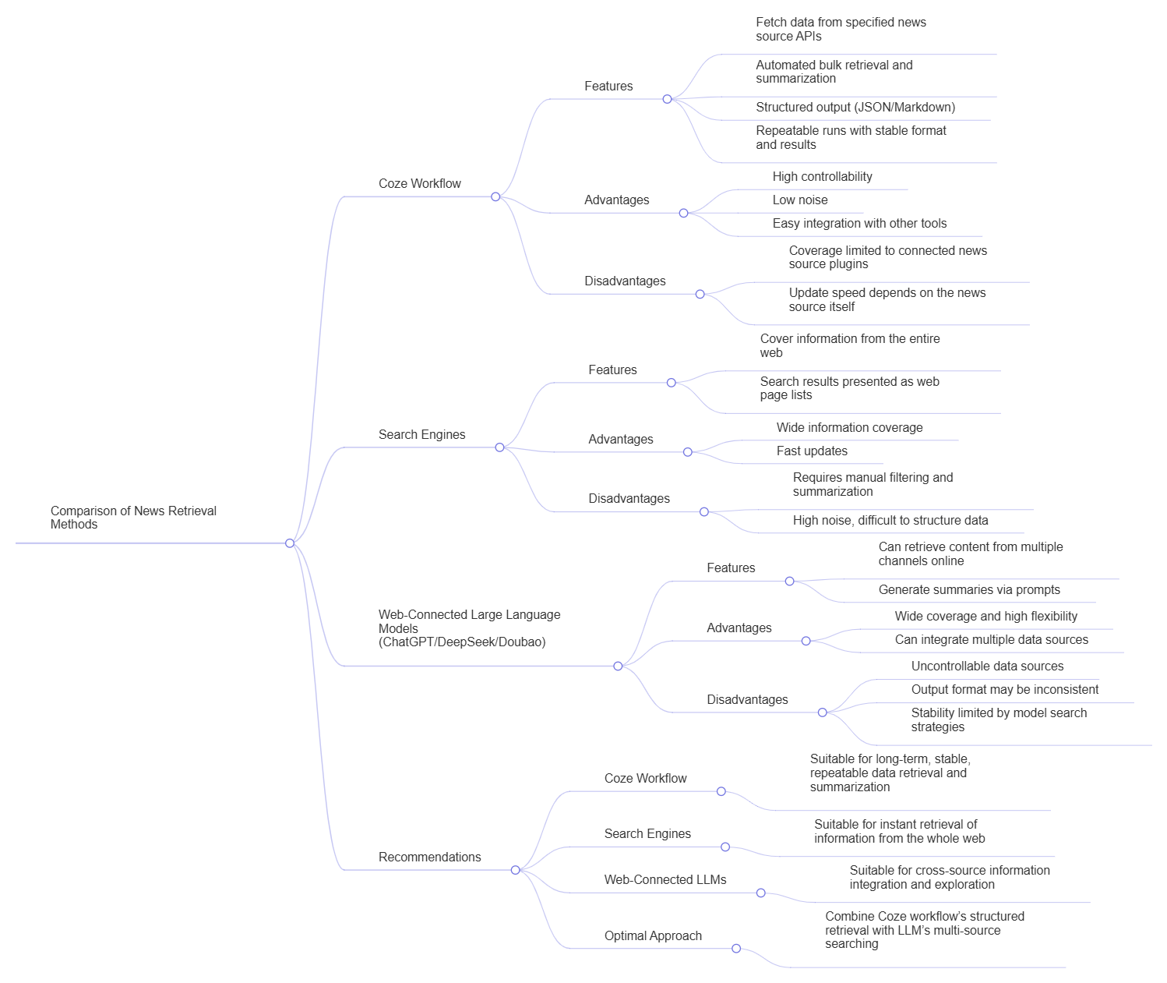

Slide 8
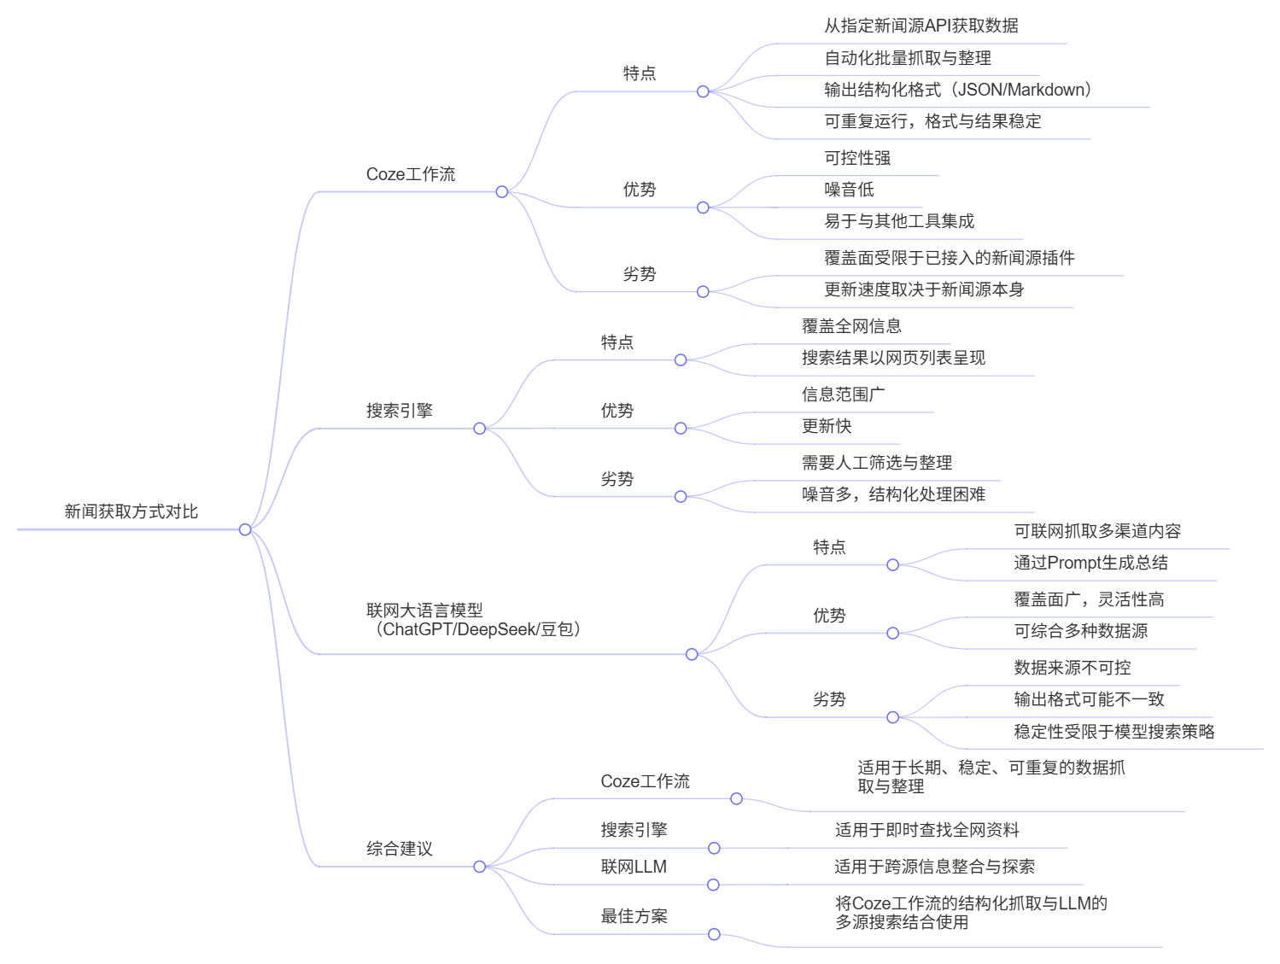

Slide 9
Class Objectives
1. Recap of 3 Agent Types
2. Workflow Agent Demo and Practice
  English Version Instruction (coze.com)
  Chinese Version Instruction (coze.cn)

Slide 10
Workflow Agent Demo
Building Agent to Collect News from Various Sources
First, I’ll demonstrate how to build an AI agent
After that, you’ll build one by yourself

Slide 11
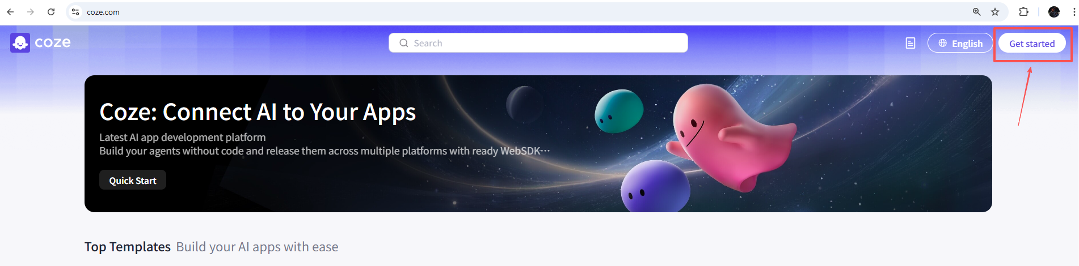
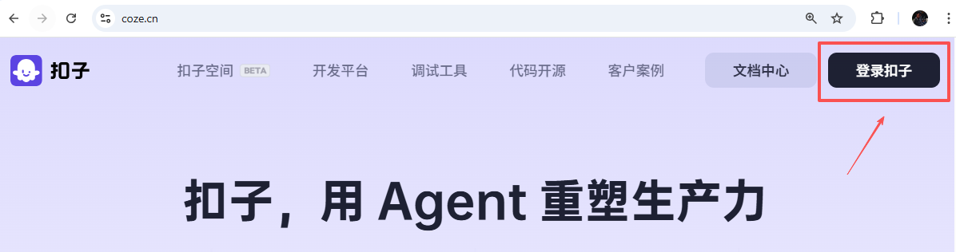
Sign up for a COZE account
https://www.coze.com/
English Version
VPN Needed
https://coze.cn/
Chinese Version

Slide 12
English Version Instructions
Notes:
https://www.cgtn.com/

Slide 13
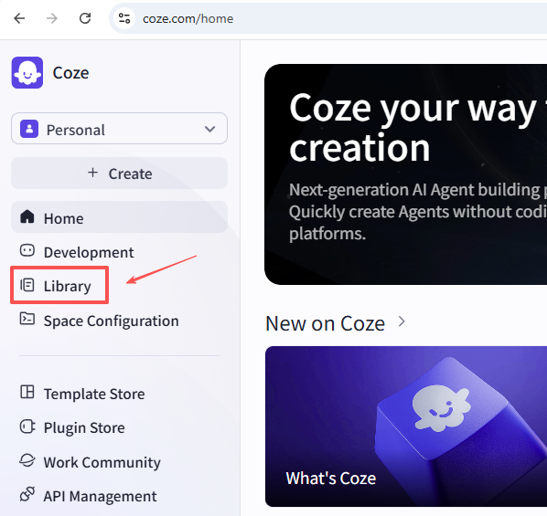
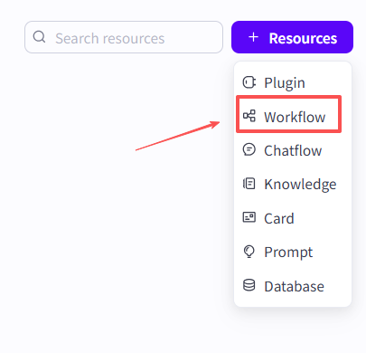

Slide 14
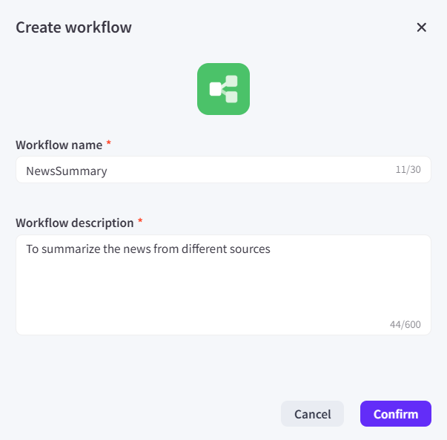
To summarize news from different sources

Slide 15
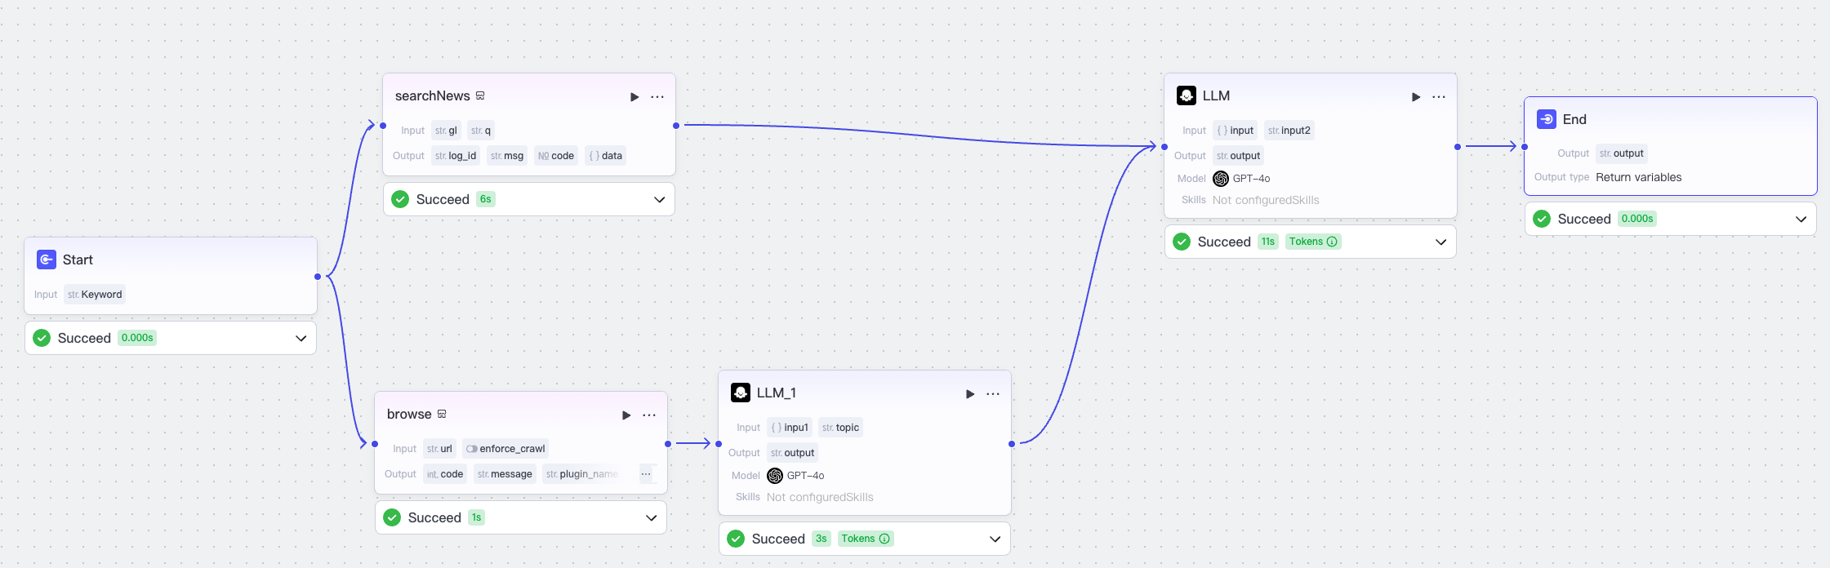
Overall Workflow

Slide 16
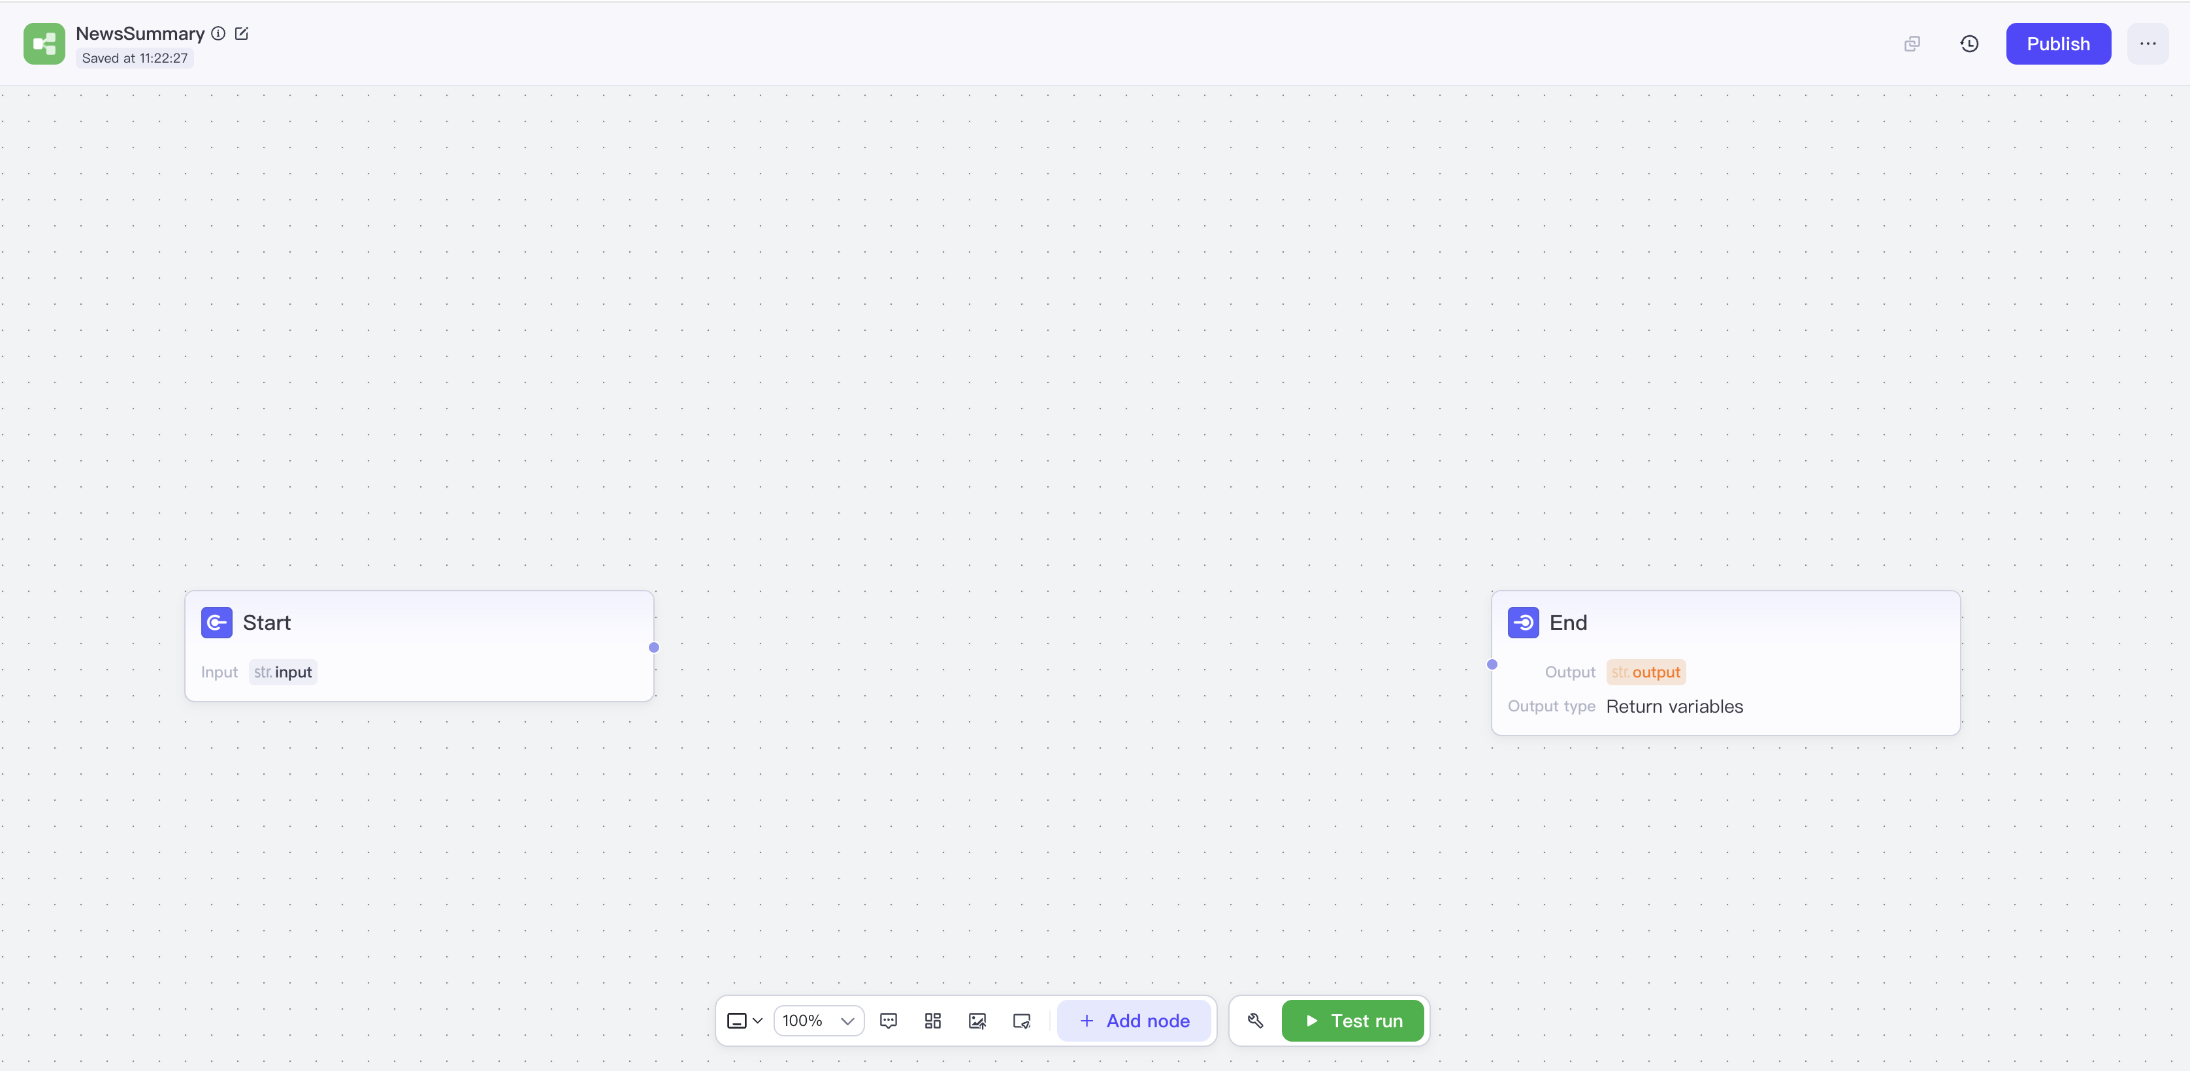
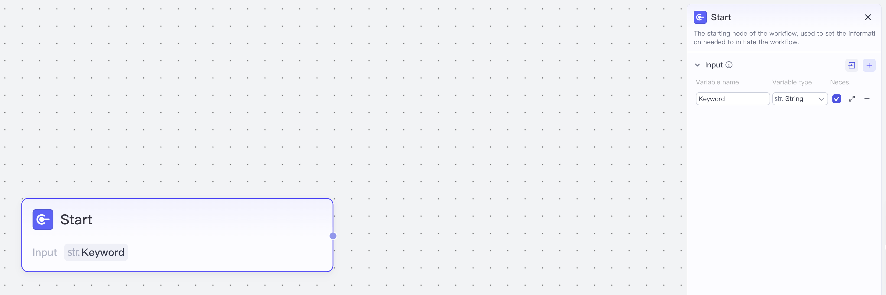
Step-by-step Instructions: Set up “Start”

Slide 17
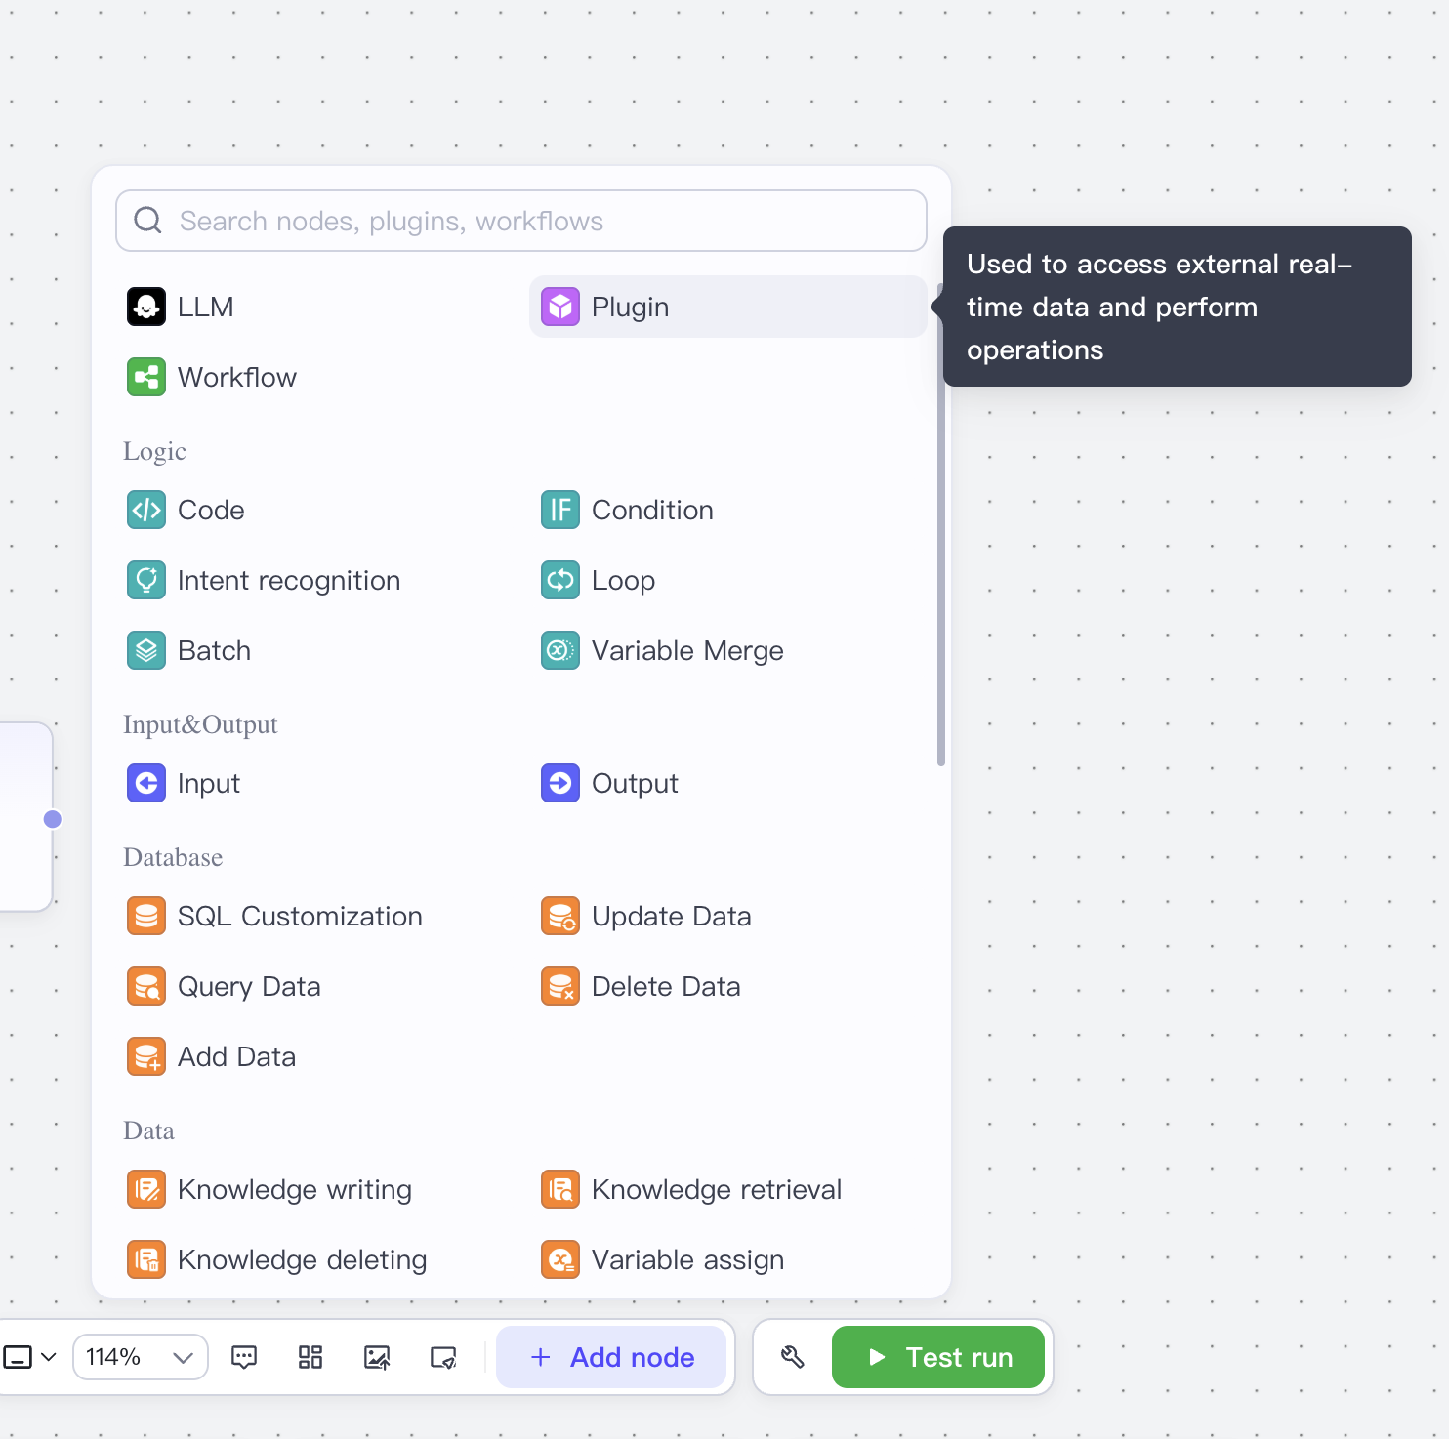
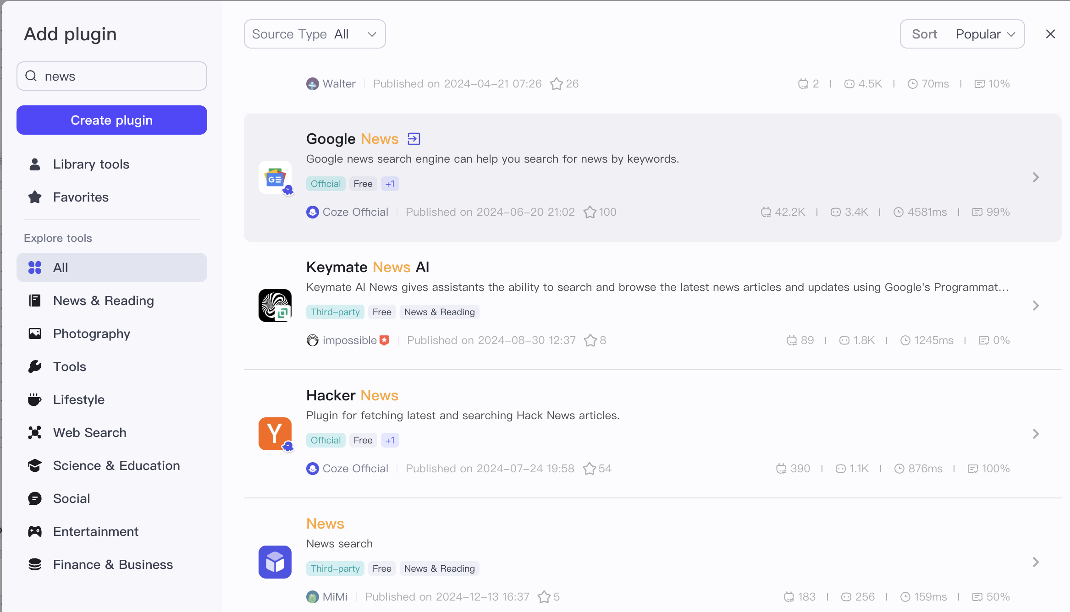
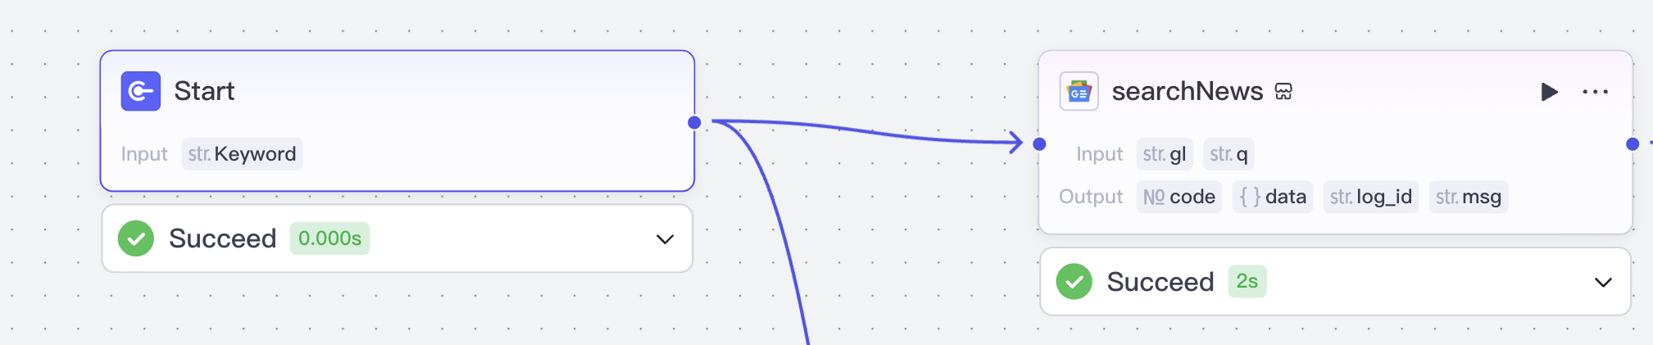
Find and Add Plugins
Connect Plugins with “Start”

Slide 18
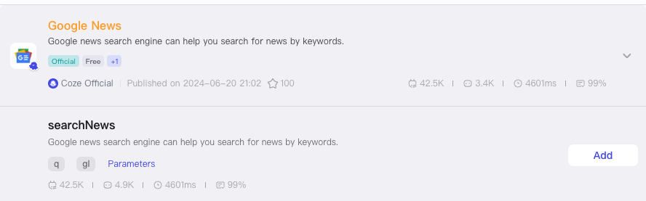
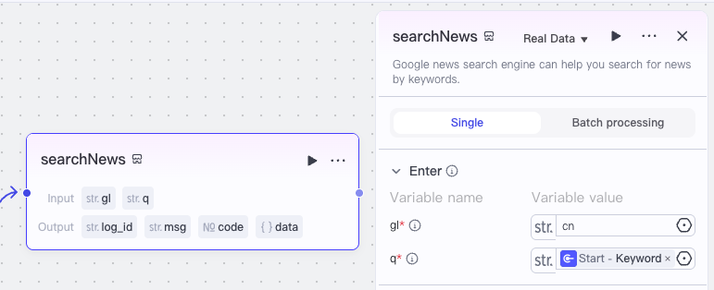
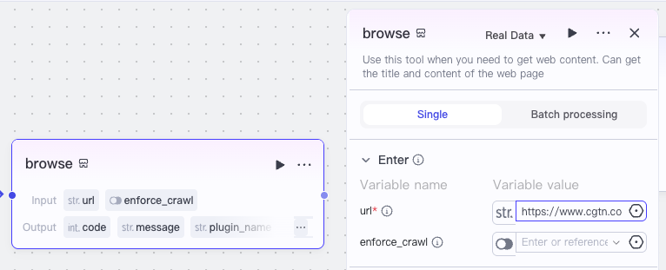
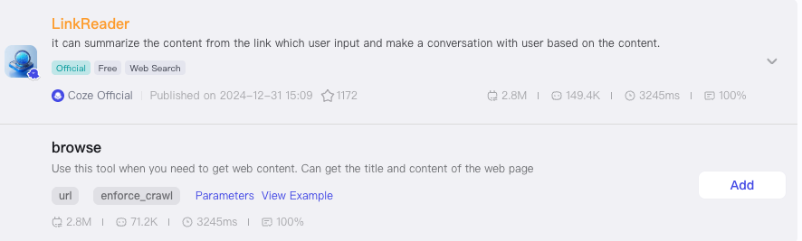
Add 2 Plugins, Connect them with “Start”, and Set up
https://www.cgtn.com/
Notes:
https://www.cgtn.com/

Slide 19
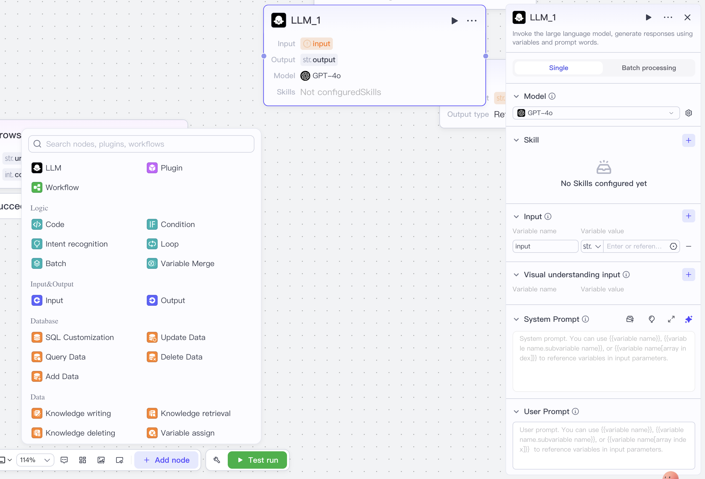
Add 2 LLMs

Slide 20
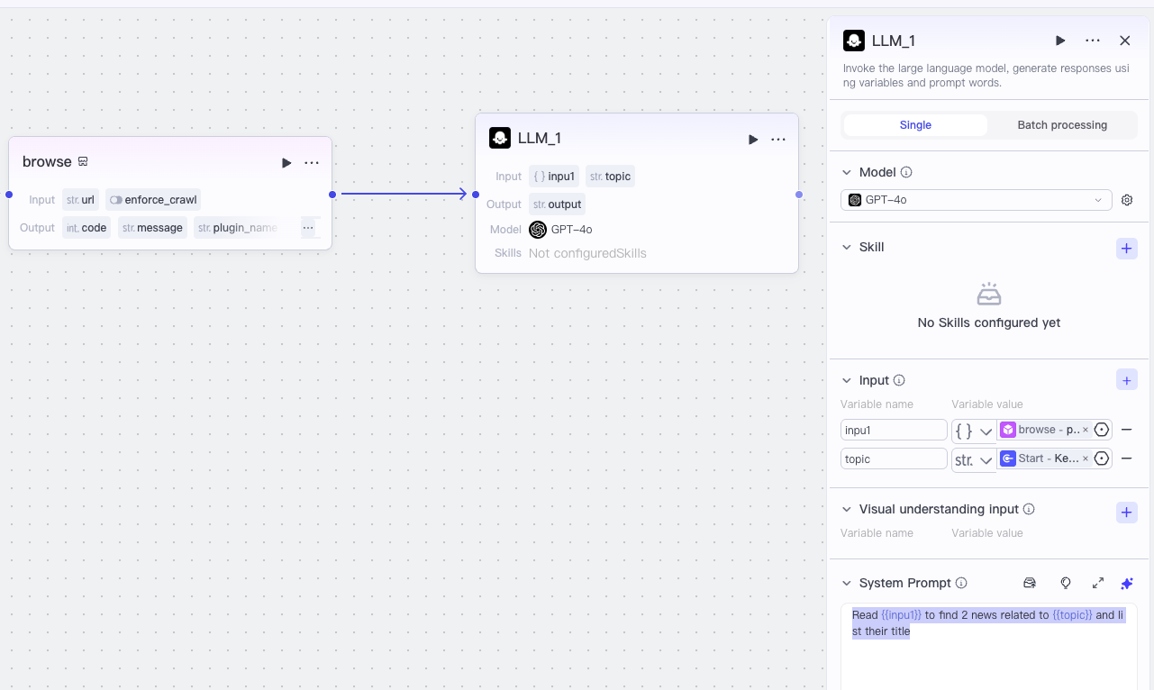

Connect “LLM_1” with “browse” and Set up
Read {{inpu1}} to find 2 news related to {{topic}} and list their title
Notes:
Read {{inpu1}} to find 2 news related to {{topic}} and list their title

Slide 21
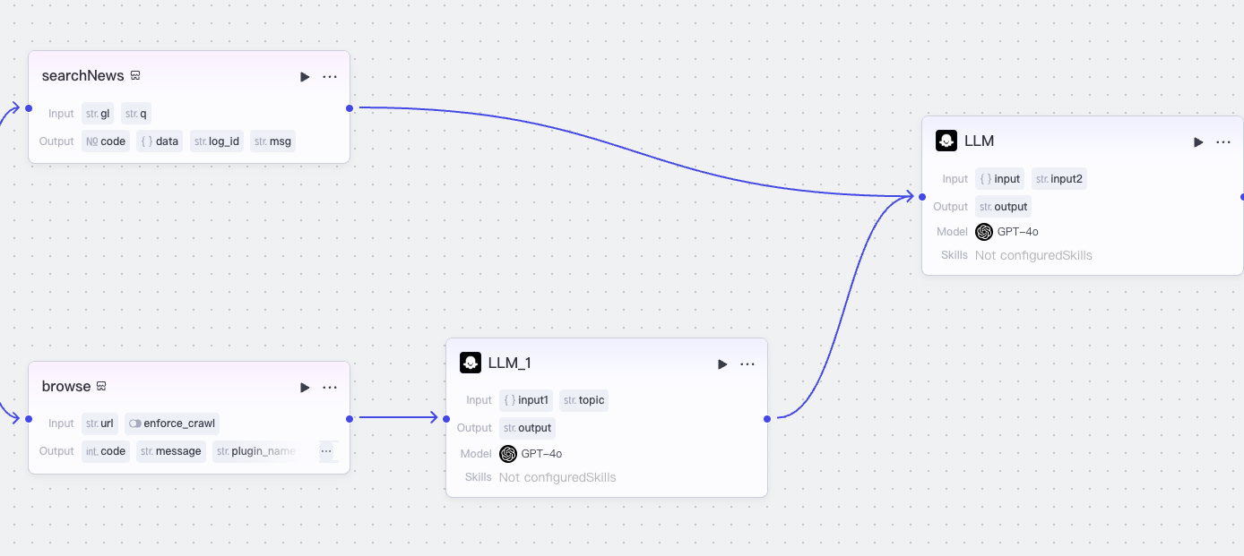
Connect “LLM” with “searchNews” and “LLM_1”
Notes:
Read {{inpu1}} to find 2 news related to {{topic}} and list their title

Slide 22
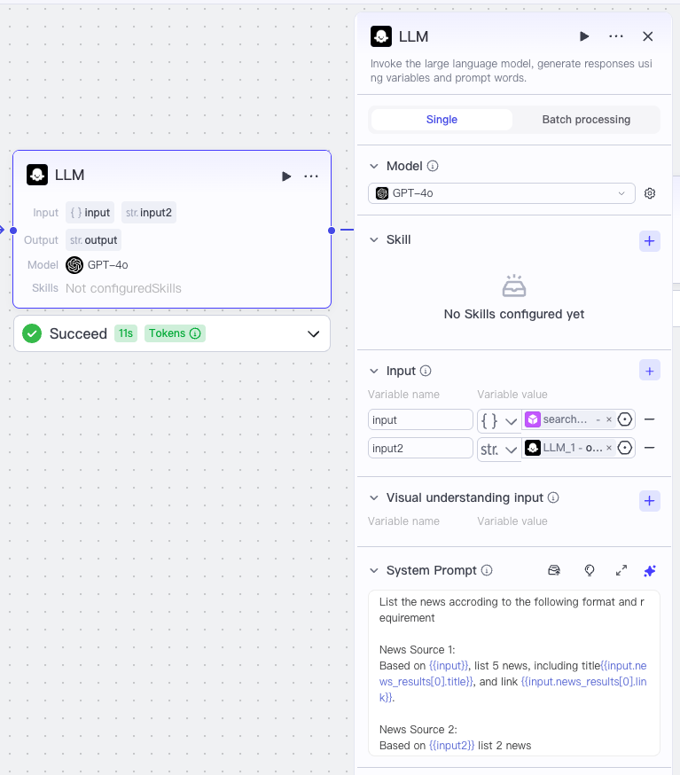
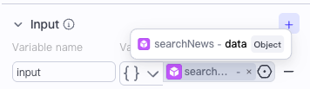
“LLM” Setup
List the news accroding to the following format and requirement
News Source 1:
Based on {{input}}, list 5 news, including title{{input.news_results[0].title}}, and link {{input.news_results[0].link}}.
News Source 2:
Based on {{input2}} list 2 news
Notes:
List the news accroding to the following format and requirement
News Source 1:
Based on {{input}}, list 5 news, including title{{input.news_results[0].title}}, and link {{input.news_results[0].link}}.
News Source 2:
Based on {{input2}} list 2 news

Slide 23
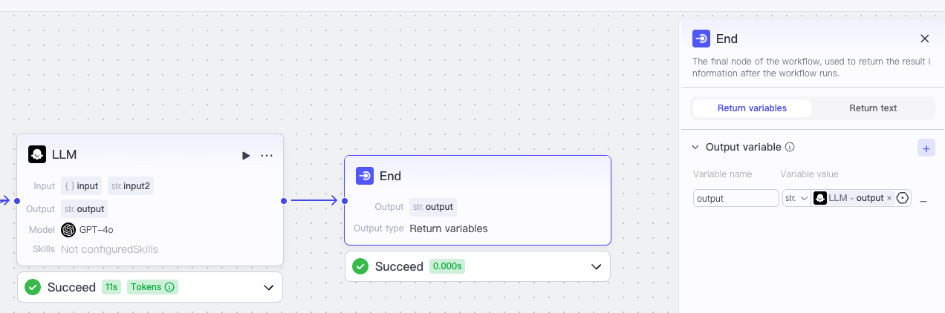
Connect “LLM” with “End” and Set up “End”

Slide 24
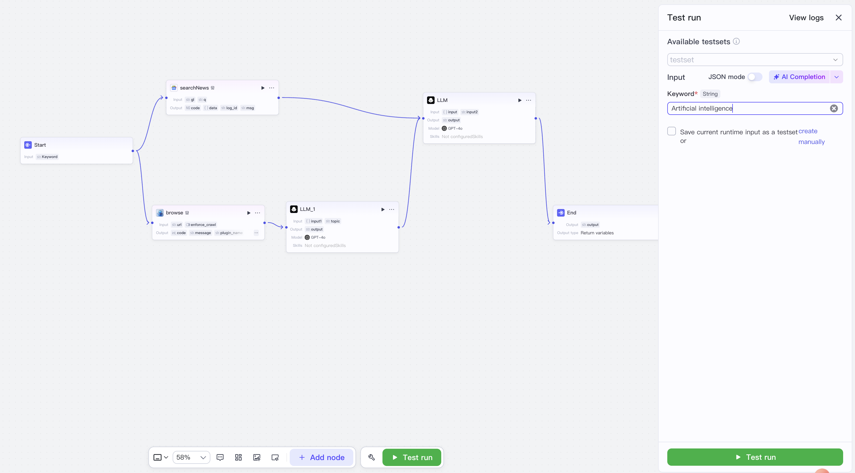
Test the Model

Slide 25
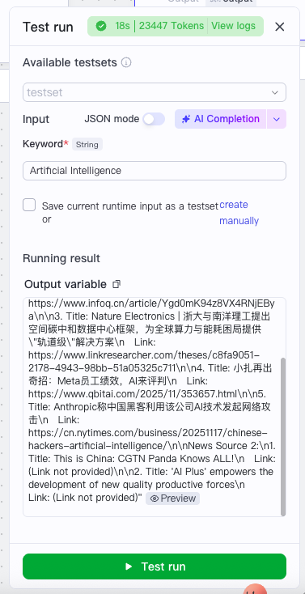
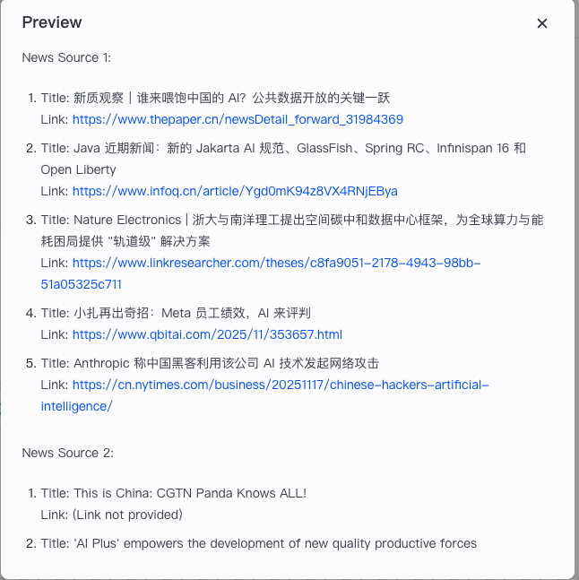

Slide 26
Chinese Version Instructions
Notes:
https://www.cgtn.com/

Slide 27
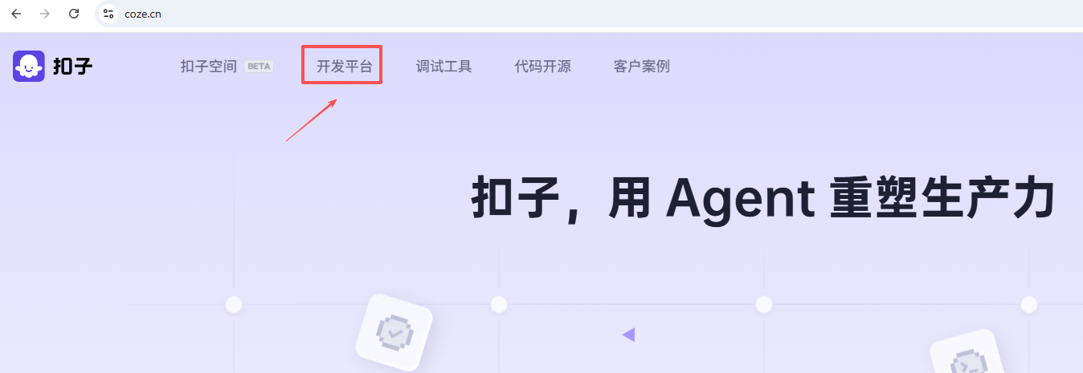
https://coze.cn/
Chinese Version

Slide 28
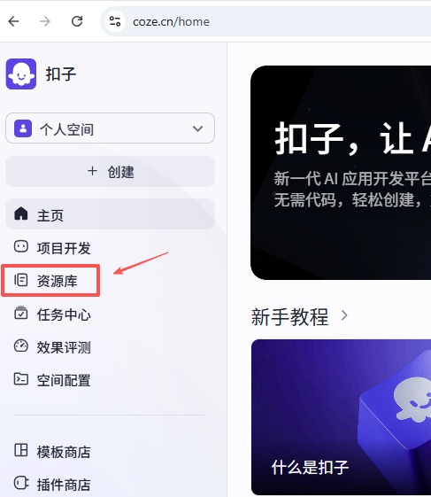
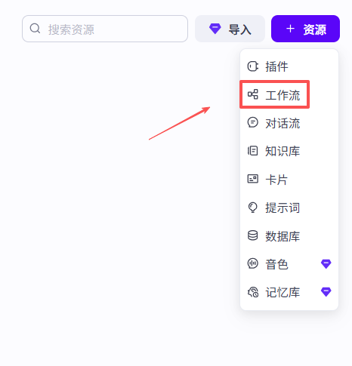

Slide 29
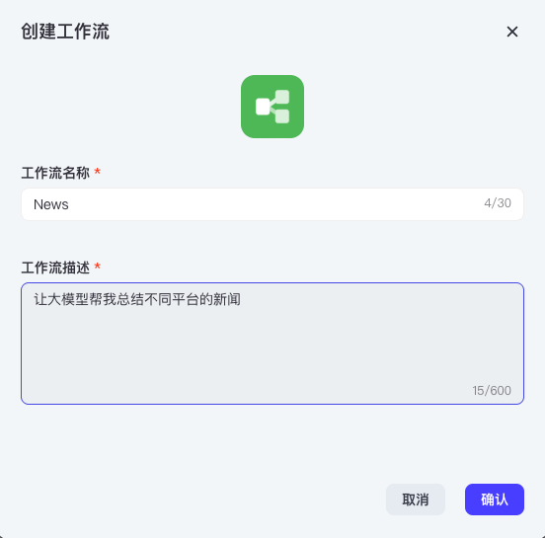

Slide 30
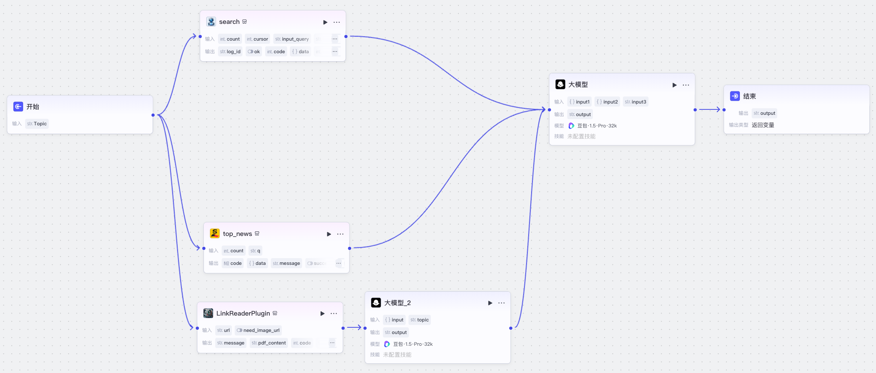
Overall Workflow
Notes:
https://www.cgtn.com/

Slide 31
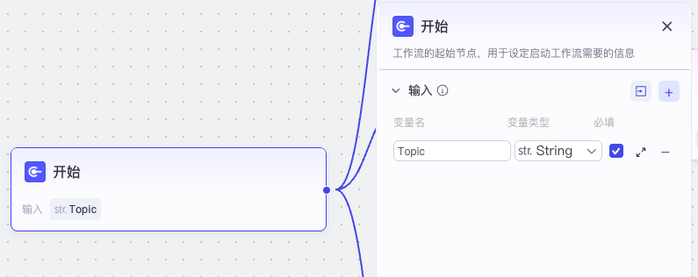
Step-by-step Instructions: Set up “开始”

Slide 32
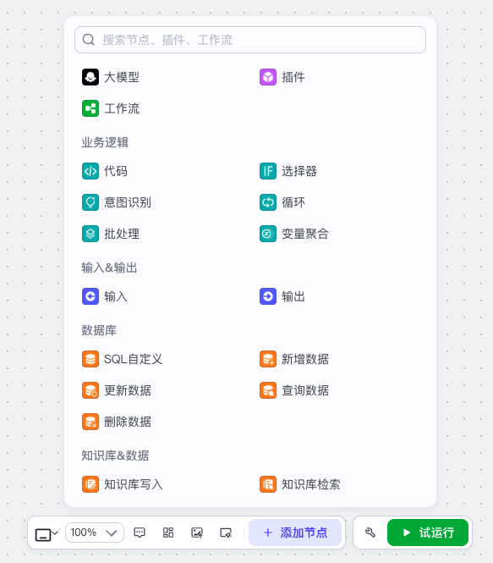
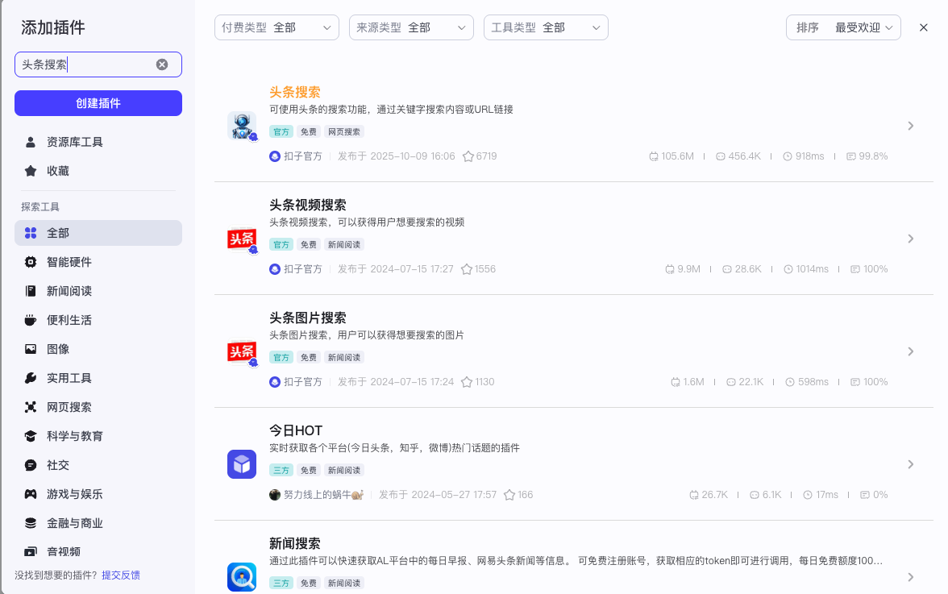
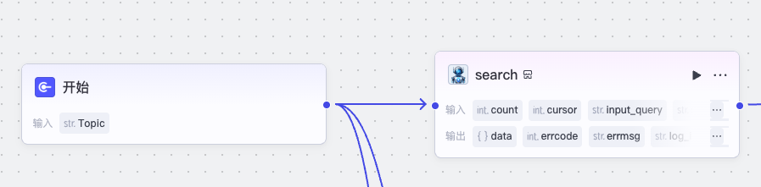
Find and Add Plugins
Connect Plugins with “开始”

Slide 33
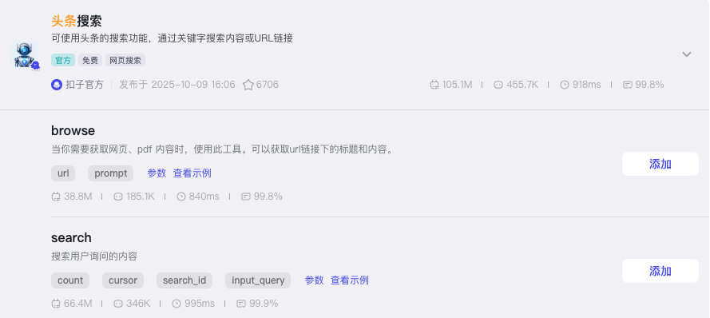
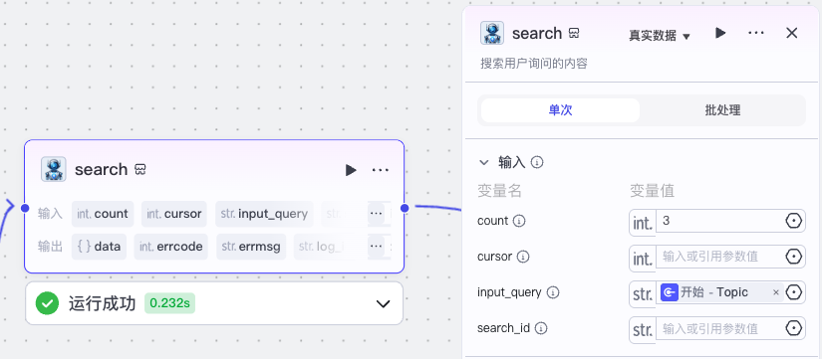
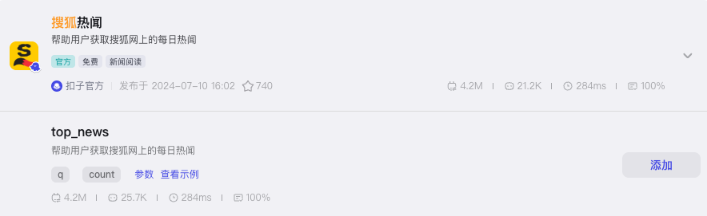
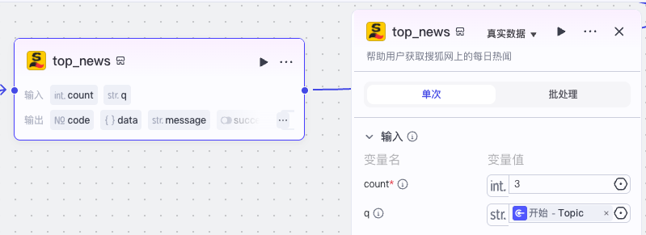
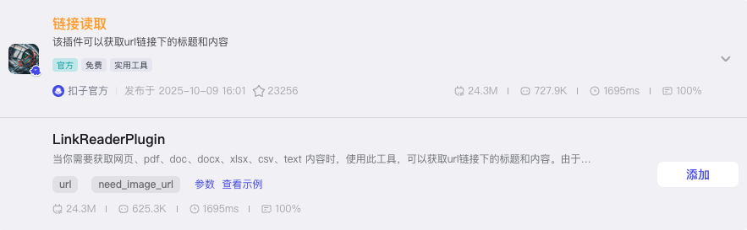
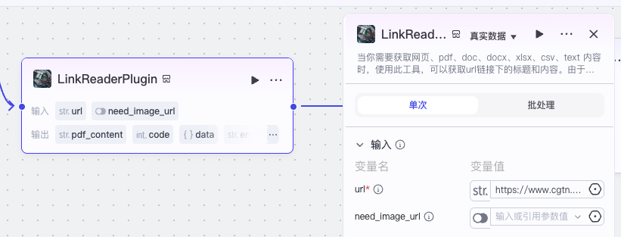
Add 2 Plugins, Connect them with “开始”, and Set up
Input url: https://www.cgtn.com/
Notes:
https://www.cgtn.com/

Slide 34
Add 2 LLMs

Slide 35
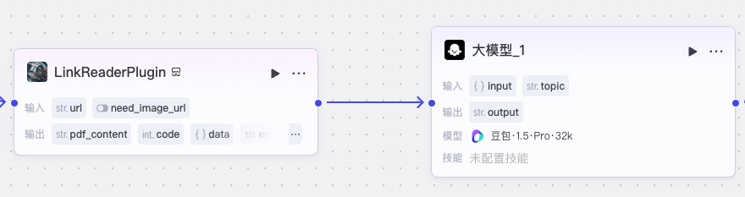
Connect “大模型_1” with “LinkReader” and Set up

Slide 36
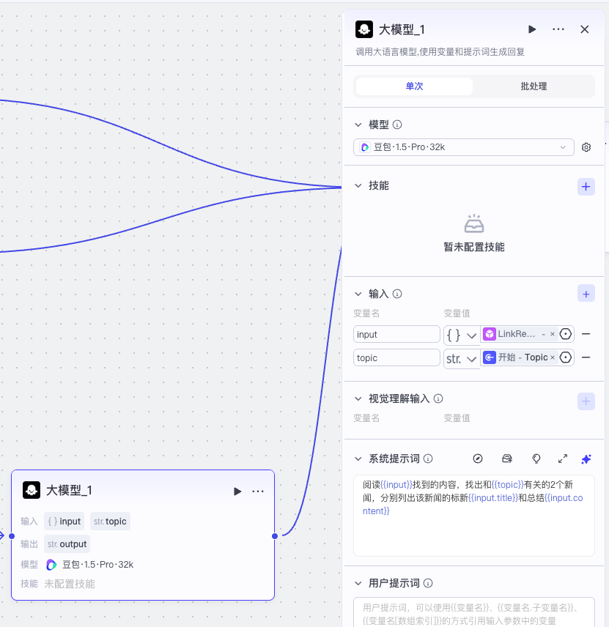
Connect “大模型_1” with “LinkReader”
Set up
阅读{{input}}找到的内容，找出和{{topic}}有关的2个新闻，分别列出该新闻的标新{{input.title}}和总结{{input.content}}

Slide 37
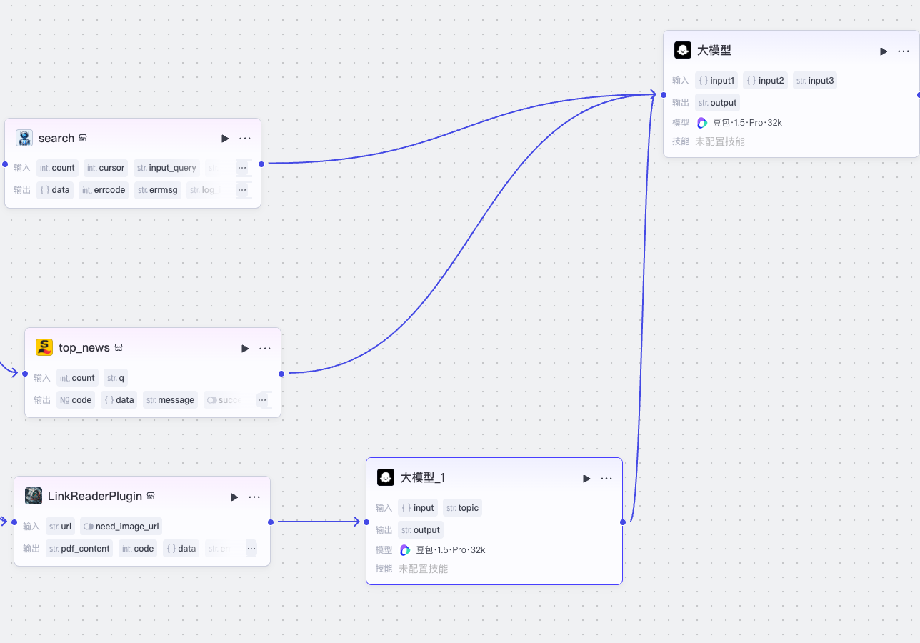
Connect “大模型” with “search”, “topnews”, and “大模型_1”

Slide 38
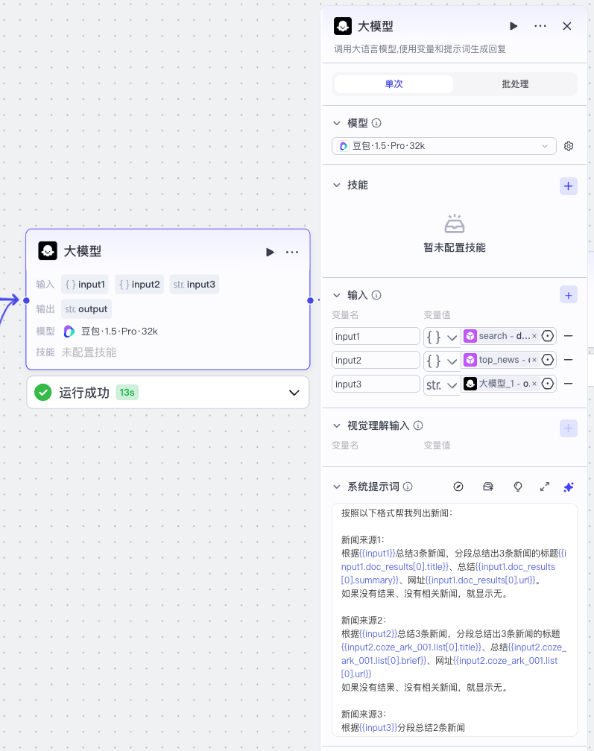
Setup “大模型”
按照以下格式帮我列出新闻：
新闻来源1：
根据{{input1}}总结3条新闻，分段总结出3条新闻的标题{{input1.doc_results[0].title}}、总结{{input1.doc_results[0].summary}}、网址{{input1.doc_results[0].url}}。
如果没有结果、没有相关新闻，就显示无。
新闻来源2：
根据{{input2}}总结3条新闻，分段总结出3条新闻的标题{{input2.coze_ark_001.list[0].title}}、总结{{input2.coze_ark_001.list[0].brief}}、网址{{input2.coze_ark_001.list[0].url}}
如果没有结果、没有相关新闻，就显示无。
新闻来源3：
根据{{input3}}分段总结2条新闻

Slide 39

Connect “大模型” with “结束”
Set up “结束”

Slide 40

Test the Model

Slide 41



Slide 42
Time for Your Practice
Building Workflow AI Agent to Collect News
https://coze.cn/ (Chinese Version)
https://www.coze.com/ (English Version)

Slide 43
Other Workflow AI Agents Platforms:
N8N:
https://www.youtube.com/watch?v=GchXMRwuWxE
OpenAI:
https://www.youtube.com/watch?v=44eFf-tRiSg

Slide 44
Questions?

Slide 45

Course Feedback

